Slide 1
CUSTOMER CHURN

Slide 2
Problem statement
Retaining customers is very crucial because it is cheaper than trying to acquire new ones. The concern is trying to identify clients about to churn early enough to be able to address the challenges. I aim to develop a model that can predict the likelihood of a shop to churn in the near future. This will assist in coming up with specific targeted strategies to minimize customer churn and hence enhance relationships.

Slide 3
OBJECTIVES
To identify features that have the most impact of churn
To build a predictive model that forecast the likelihood of a customer churn
To derive actionable recommendations for reducing churn based on the insights from the analysis

Slide 4
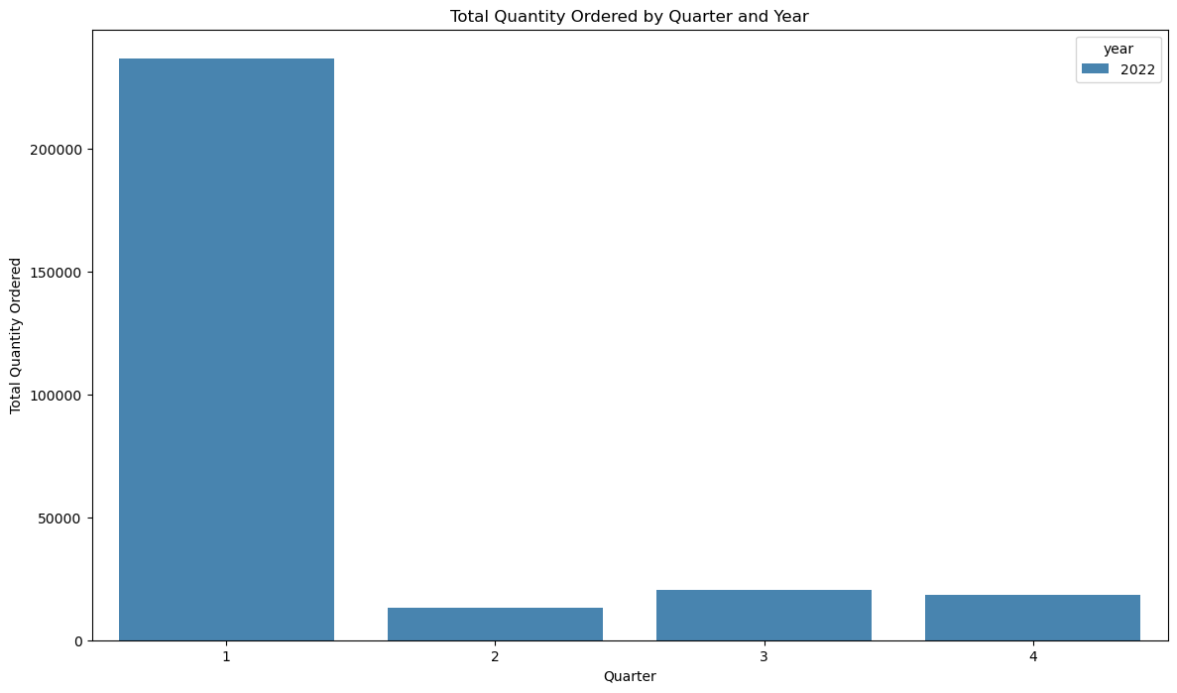
TOTAL QUANTITY ORDERED BY QUARTER
The 1st quarter of the year is when the highest quantity is ordered. Q2 experiences the lowest amount of quantity ordered
They should focus on giving discounts in Q2 where the total quantity is low

Slide 5
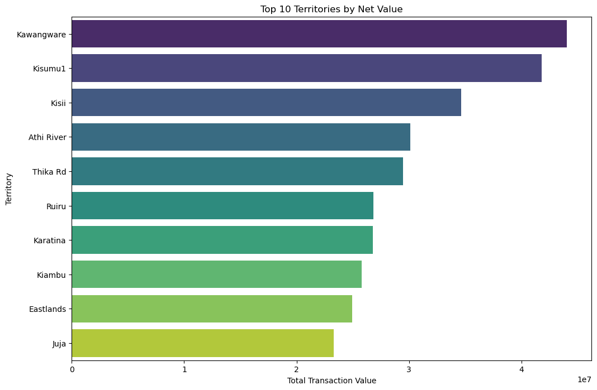
TOP 10 TERRITORIES BY NET VALUE
These are the top 10 territories by the net value. It basically shows us the worth of what they are purchasing.
This helps in showing areas that bring the most values hence can be given loyalty programs

Slide 6
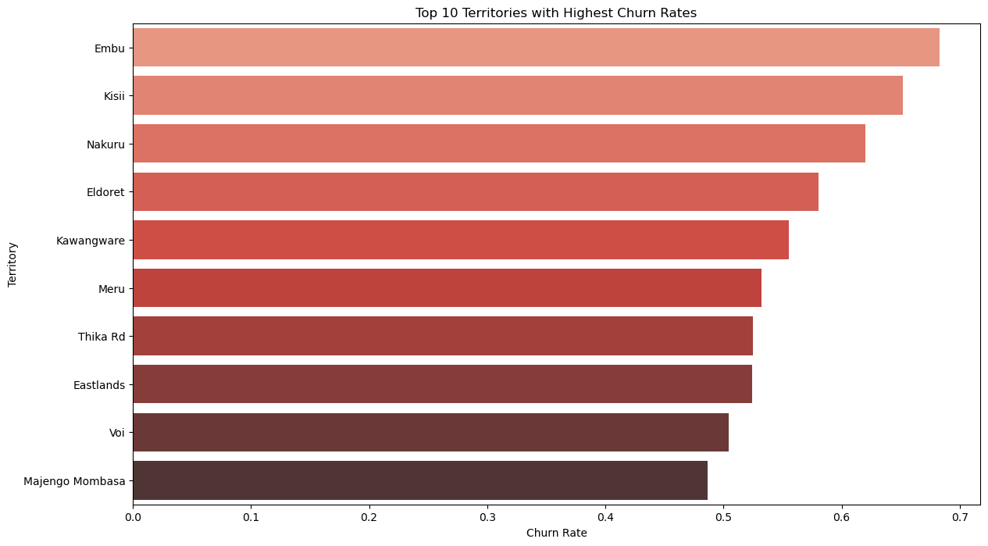
CHURN RATE BY TERRITORY
Classification Report: precision recall f1-score support 0 1.00 1.00 1.00 4428 1 1.00 1.00 1.00 4314 accuracy 1.00 8742 macro avg 1.00 1.00 1.00 8742 weighted avg 1.00 1.00 1.00 8742 Accuracy: 1.0
These are the territories that are most likely to churn hence they should focus more engagement on them.

Slide 7
MODELLING – LOGISTIC REGRESSION
Recall: Recall calculates the proportion of correctly identified churned customers among all actual churned customers..
The recall for the decision tree model is 100%. A recall score of 1.oo indicates that the model correctly identified approximately 100% of the total positive instances (churned customers) in the dataset.
Overall model accuracy is 100%, indicating that the model correctly predicted the churn or no-churn status for approximately 100% of all customers.
Classification Report:
precision recall f1-score support
0 1.00 1.00 1.00 4428
1 1.00 1.00 1.00 4314
accuracy 1.00 8742
macro avg 1.00 1.00 1.00 8742
weighted avg 1.00 1.00 1.00 8742
Accuracy: 1.0

Slide 8
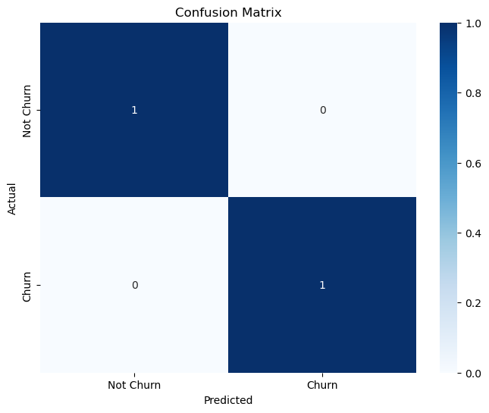
MODELLING – logistic regression

Slide 9
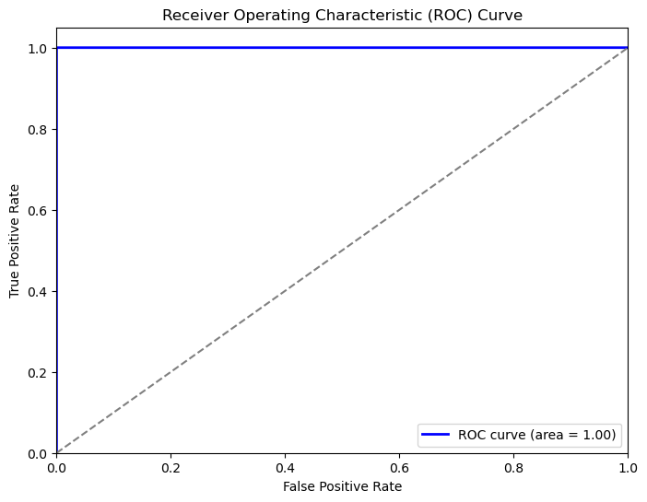
MODELLING
AUC of 1.0 and is hugging the top left side of our graph, it also has a high recall when predicting whether a customer will churn

Slide 10
RECOMMENDATIONS
Focus engagement on areas that have clients who are more likely to churn
Create more focused engagement to increase customer lifetime value- these include creating different pricing strategies to target areas.
Create a loyalty program for areas with the most quantity ordered

